Slide 1
UNIT II
FREQUENCY TRANSFORMATIONS
2.1 INTRODUCTION TO DFT
2.2 PROPERTIES OF DFT
2.3 FILTERING METHODS BASED ON DFT
2.4 FFT ALGORITHMS DECIMATION IN TIME ALGORITHMS
2.5 DECIMATION – IN – FREQUENCY ALGORITHMS
2.6 USE OF FFT IN LINEAR FILTERING
2.7 DCT.

Slide 2




2.1 Introduction to DFT:
DFT is useful in transformation of signal from one domain (time) to another domain(frequency).
Here “k” indicates the index of frequency& “N” is the length of input sequence x(n).
The IDFT is defined as,
TWIDDLE FACTOR

Slide 3






64.Determine the 4-point DFT of,

Slide 4



Slide 5











65.Find the IDFT of X(k)= { 4,0,0,0}

Slide 6





66.Practice:Find 8-point DFT of x(n)={1,2,3,4}
Here N=4; But we have to find for 8 point;So append zeros,such that,
x(n)={1,2,3,4,0,0,0,0}; Hence N=8;
67.Practice: Find the IDFT of
68.

Slide 7

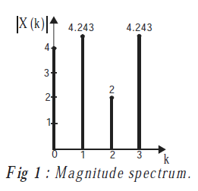
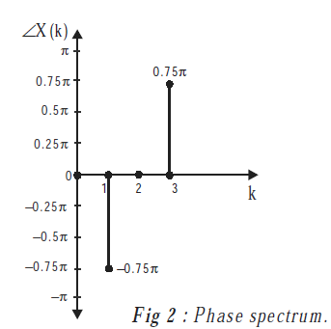



Slide 8


69.Find the DFT of x(n)={1,2,3,4} by using twiddle factor.
70.Practice:Find IDFT of X(k)={10,-2+2j,-2,-2-2j}

Slide 9




Find the circular convolution of by DFT-IDFT method
similarly
Thus

Slide 10






Slide 11



Thus
2.6 Use of FFT in linear filtering:

Slide 12


77.

Slide 13



Slide 14
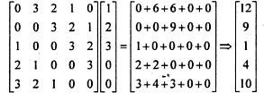
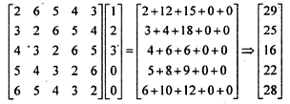
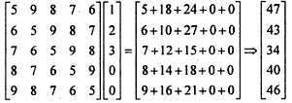

Slide 15
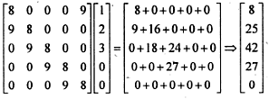
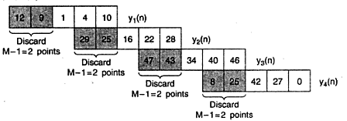

Slide 16
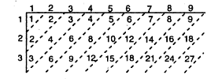
78.

Slide 17



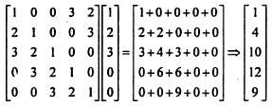

Slide 18
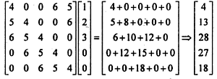
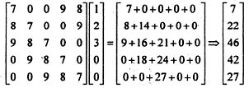
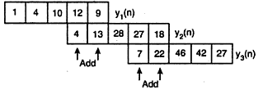

Slide 19

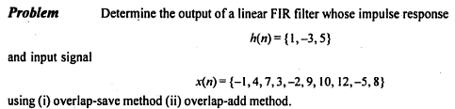
79.
Practice:

Slide 20






2.2 Properties of DFT:

Slide 21






Slide 22






Slide 23









Slide 24





Since
Thus

Slide 25




Slide 26






Slide 27






Slide 28




8

Slide 29







9.Complex conjugate property:
Note:
Similarly by using IDFT formula, next equation can be proved.

Slide 30

FFT: (Fast Fourier Transform)

Slide 31
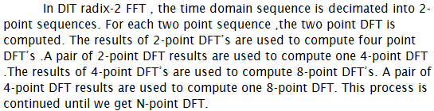


2.4 Decimation In Time (DIT) Algorithm:

Slide 32





Slide 33







Slide 34


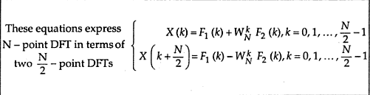
Similarly can be done for 4point and 2 point DFT’s

Slide 35



Slide 36
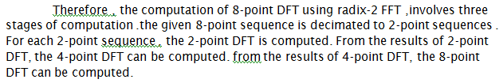
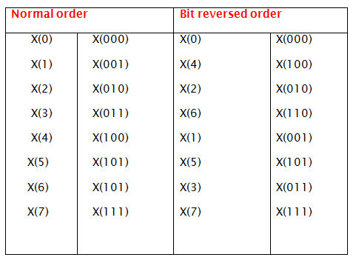

Slide 37
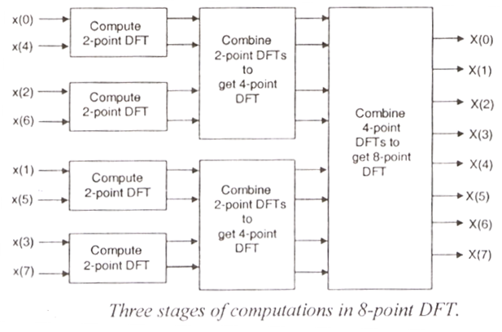

Slide 38
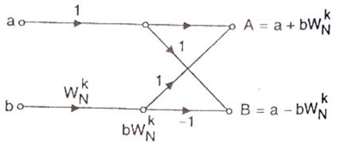


Slide 39
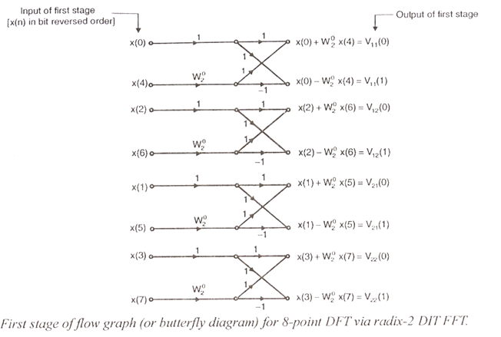

Slide 40
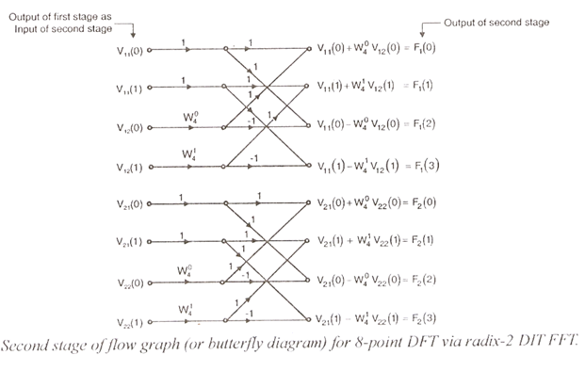

Slide 41
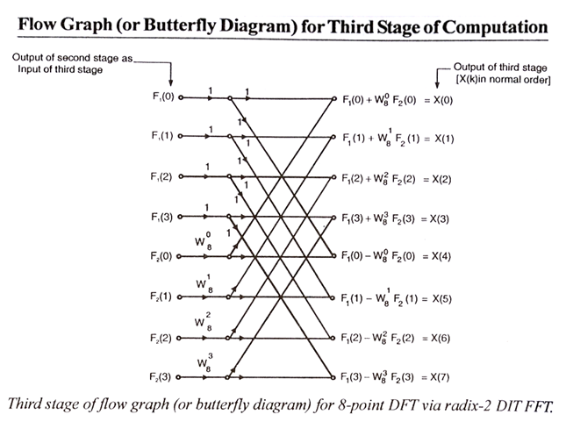

Slide 42
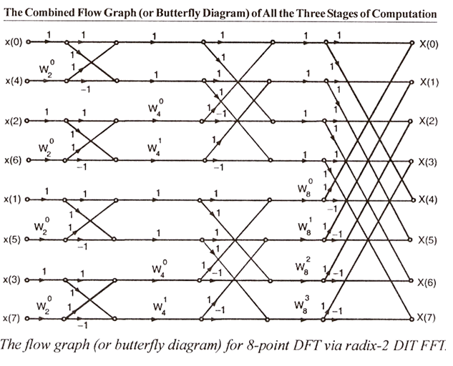

Slide 43
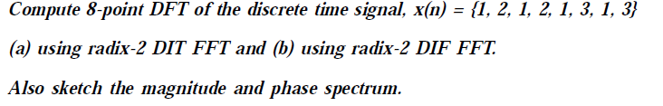
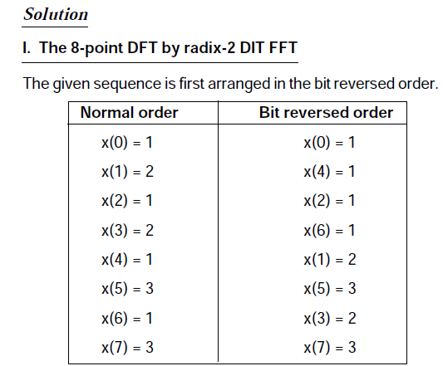

Slide 44

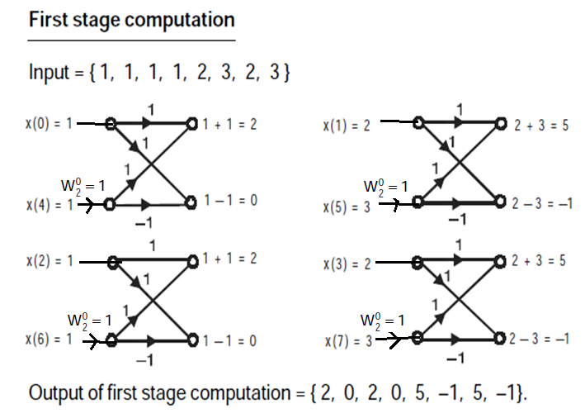

Slide 45

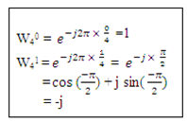
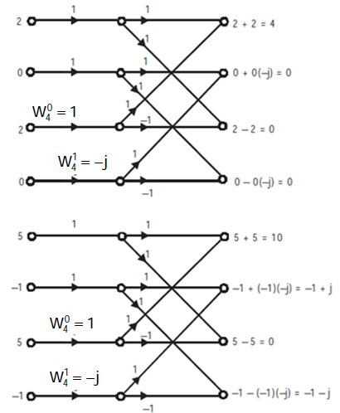

Slide 46
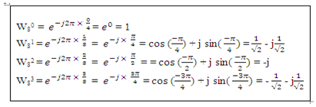

Slide 47

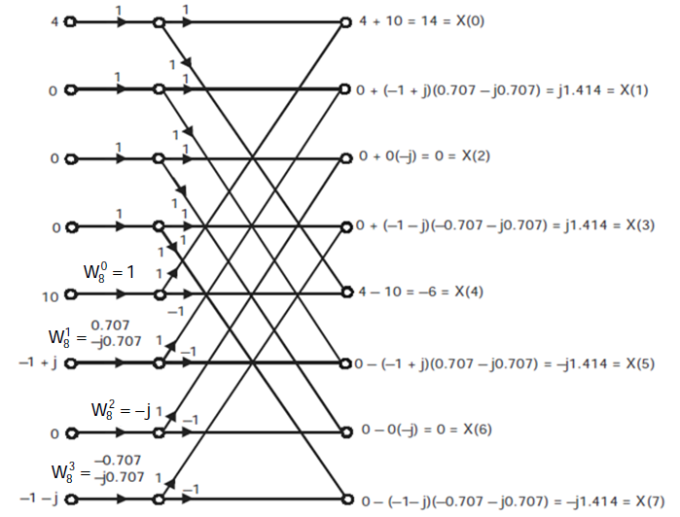

Slide 48
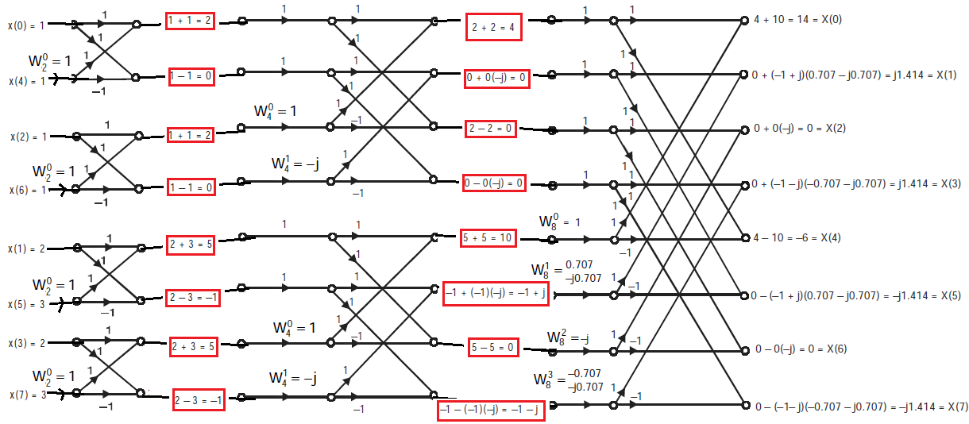
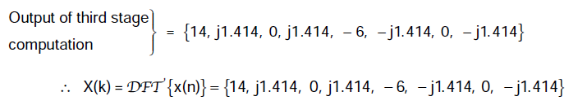

Slide 49
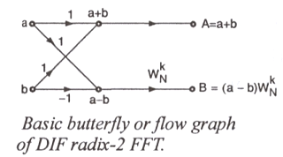

Slide 50
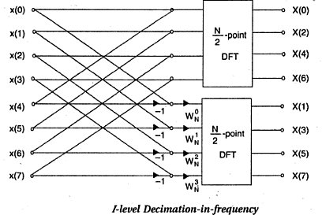

Slide 51
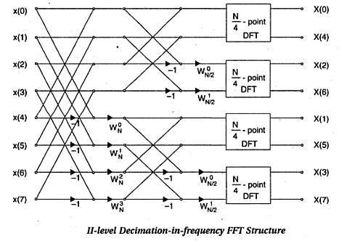

Slide 52
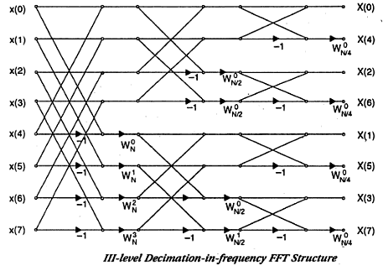

Slide 53
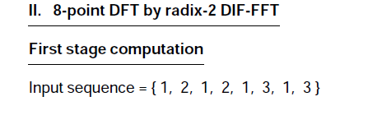
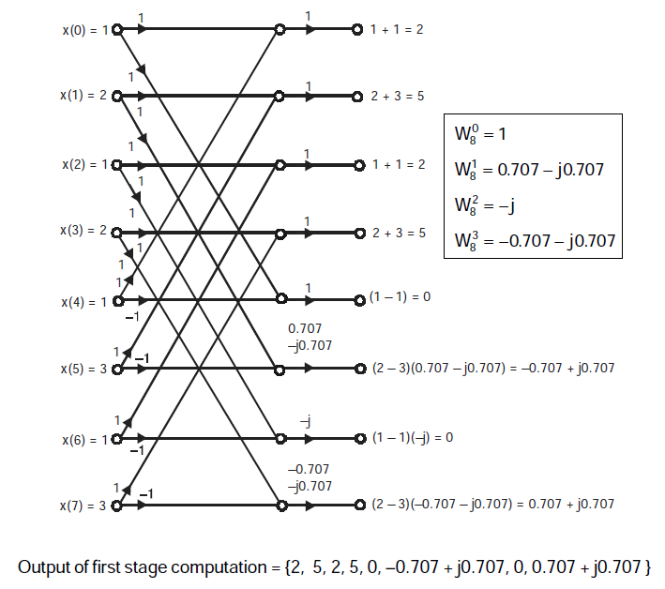
73.

Slide 54
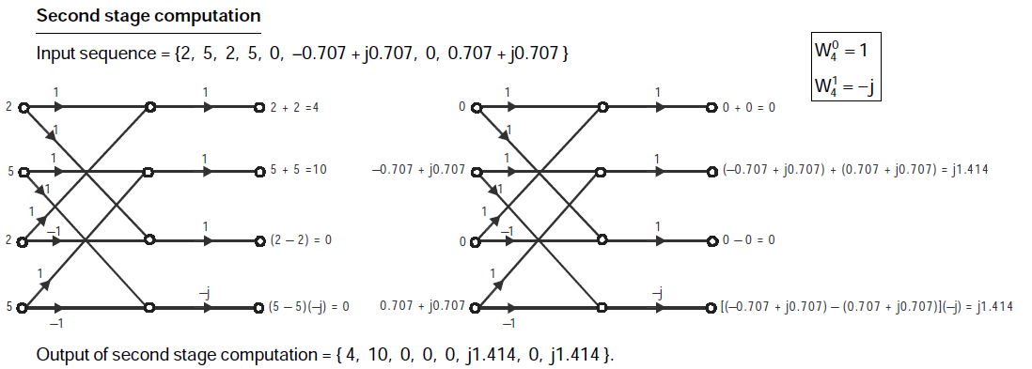

Slide 55
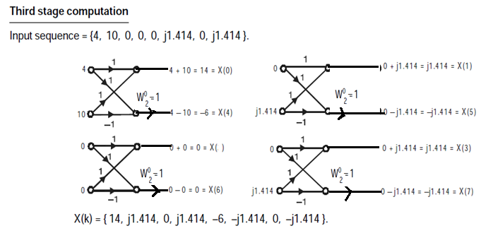

Slide 56
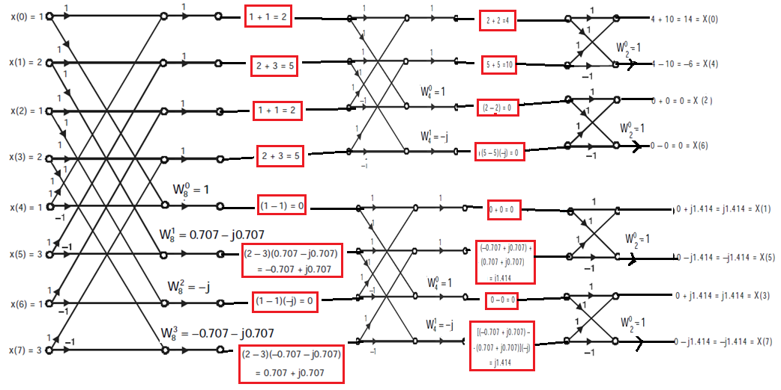

Slide 57
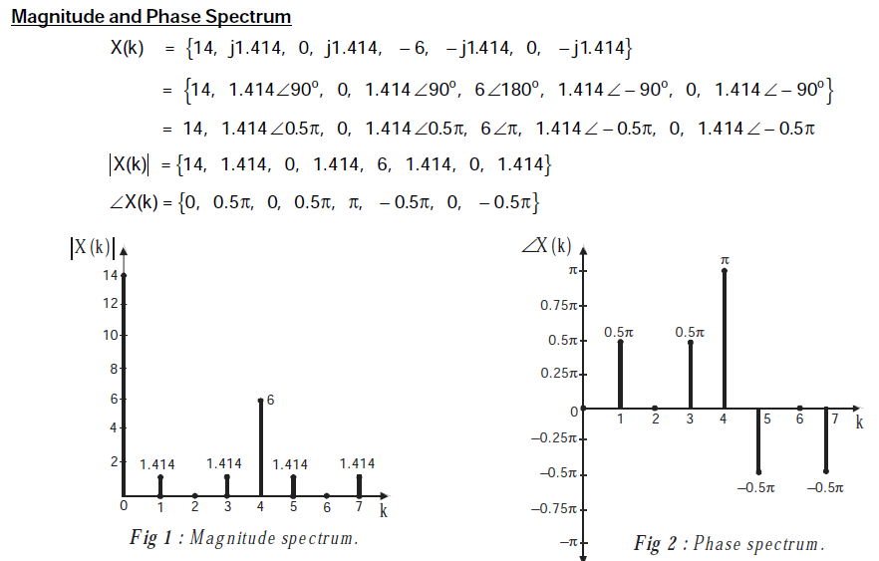

Slide 58



Slide 59
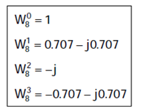

Slide 62



Slide 63





Slide 64


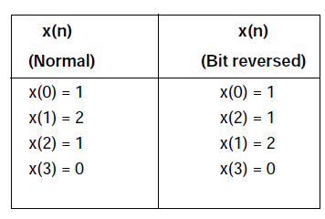
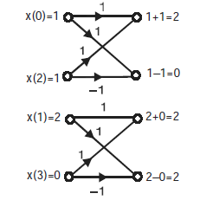


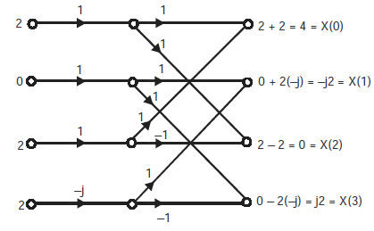


Slide 65


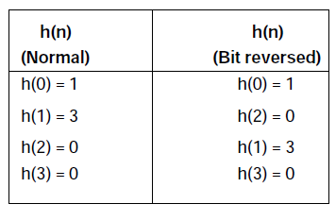
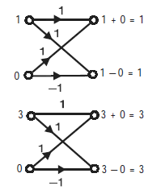


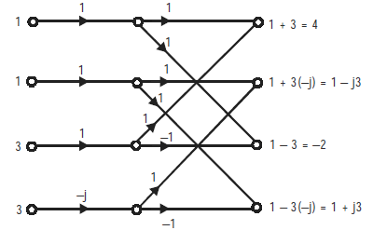


Slide 66



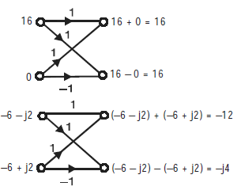




Slide 67





Slide 68







Slide 69





Slide 70





